Slide 1
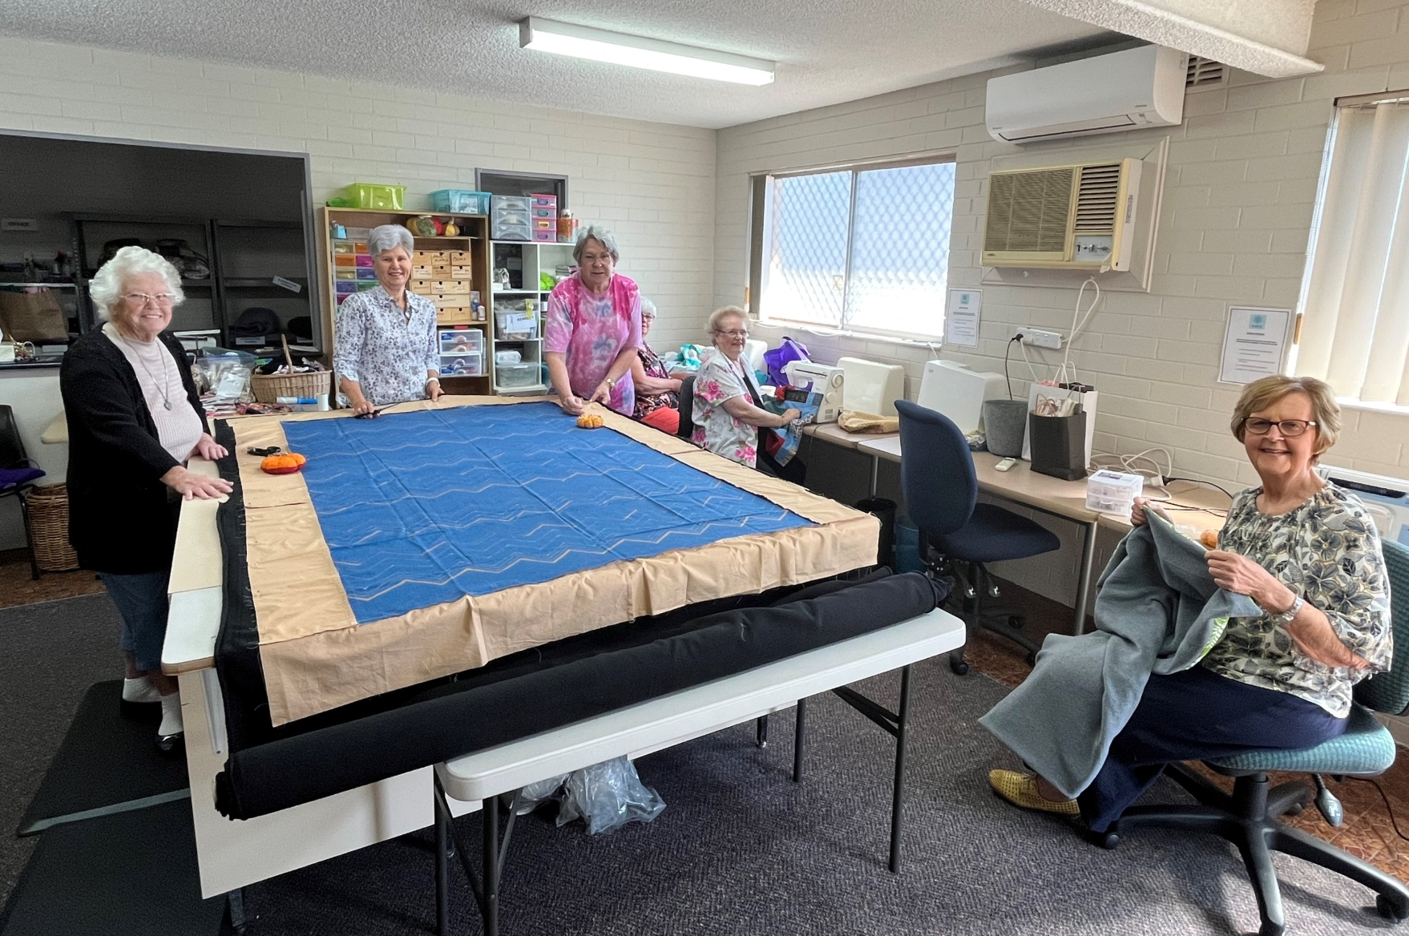
WARM BLANKETS FOR EVERYONE
2024 KEY
HIGHLIGHTS & STATS.

Slide 2
OUR STORY
Warm Blankets For Everyone (WBFE) became incorporated as a Not-for-Profit Charitable Organisation in November 2020. It has a board of 8 members to oversee the operation. WBFE currently has over 120 volunteers, who create blankets either at the Belmont workshop or at home. Currently there is the capacity to produce around 2,000 fleece backed blankets each year. Of this, approximately 1,400 blankets are made with purchased fleece and 600 from donated fleece. WBFE volunteers also make over 700 crochet / knitted blankets each years as well as many beanies, gloves, jumpers etc.
WBFE does not deal directly with people in need but supplies blankets to a range of support organisations who distribute the blankets to their clients. There are approximately 38 organisations that have been supported in recent times. Currently there are 14 local organisations that are supplied with blankets on a regular ongoing basis based on need. Other Organisations will approach WBFE for blankets on an “adhoc” basis. WBFE is in regular contact with all the organisations supported to ascertain their needs and remind them that support is available.
The organisations supported include Refuges, Homeless Support Groups, Crisis Centers and Rehabilitation Program Centers. The excellent quality blankets that are supplied are always greatly appreciated. The blankets not only provide warmth but comfort, support and security to those in need, including people experiencing homelessness, low income or transition out of prison.
In 2020 and 2021 WBFE supplied over 2,000 blankets each year. In 2022 over 2,200 blankets were supplied. In 2023 WBFE supplied 2,794 blankets. In 2024 WBFE was able to supply 3.557 blankets to organisations to support the most vulnerable people in our community.
The blankets are made predominately from donated fabric and wool and the backing fleece for the blankets is mainly purchased. It is critical to provide the warmth required so quality polar fleece is used. This type of fleece is extremely popular for outdoor garments, mainly due to its thickness and warmth. It is also a popular material for blankets, as polar fleece provides outstanding protection against the cold. An additional benefit in using polar fleece is that it is made from recycled PET (polyethylene terephthalate) bottles.
WBFE volunteers also raise funds to support the operation. There is an extremely proactive and dedicated Fundraising Committee which has raised around $15,000.00 from events in the 2024 financial. However, the money raised by the Committee is not sufficient to cover the full cost of the WBFE operation which is between $26,000 - $30,000 depending on the amount of polar fleece purchased.
Receiving Grant funding is vital to the ongoing ability for WBFE to continue to operate at the current rate and provide the support needed to meet the critical objectives of community support organisations. WBFE was very fortunate to receive a Grant from the Newcastle Permanent Charitable Foundation in 2024 for $20,000. This enabled sufficient fleece to be purchased to make over 1,200 blankets. Other Grants have allowed for the purchase of vital equipment to keep WBFE operating efficiently.
WBFE Blankets are extremely valued by our clients, and they provide great warmth, comfort and support to the most vulnerable people in our community. Unfortunately, in the current economic climate the need is increasing with the expectation the WBFE will not only continue at current levels but increase output.

Slide 3
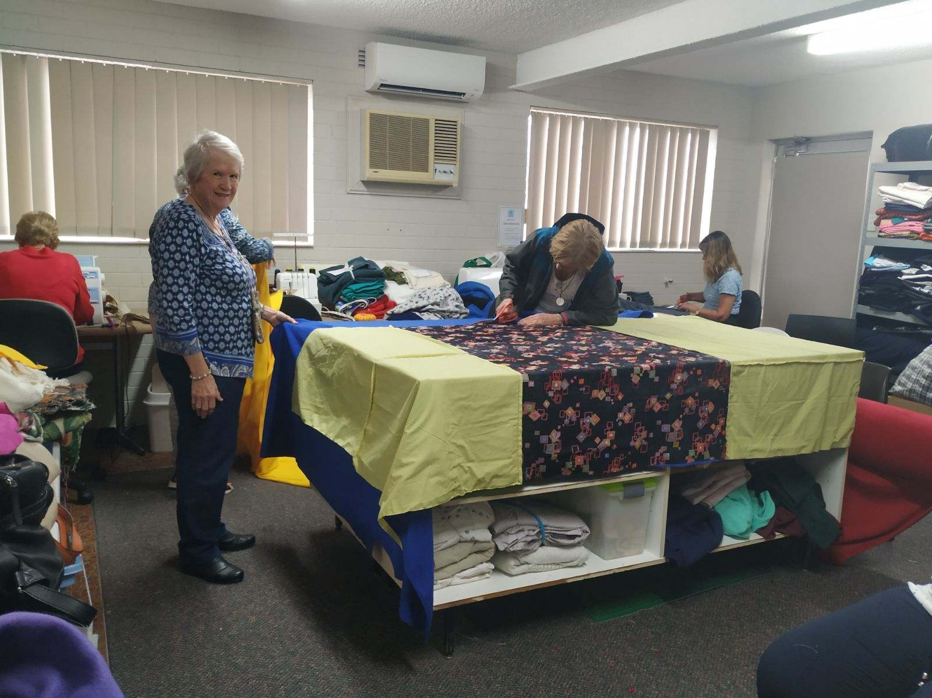
Volunteers
Fleece
125 Recorded Volunteers
43 Workshop attendees
42 Home based sewers
34 Home based Crocheters / Knitters
6 Drivers
6 other
32 rolls in storage at 28/1/24
84 rolls purchased during 2024
109 rolls used during 2024
5 rolls in storage at 16/12/24
2 rolls unused at the Workshop
Blanket Pinning
1,148 pinned from Polar fleece
420 pinned from remnant fleece
1,568 Blankets pinned in total

Slide 4
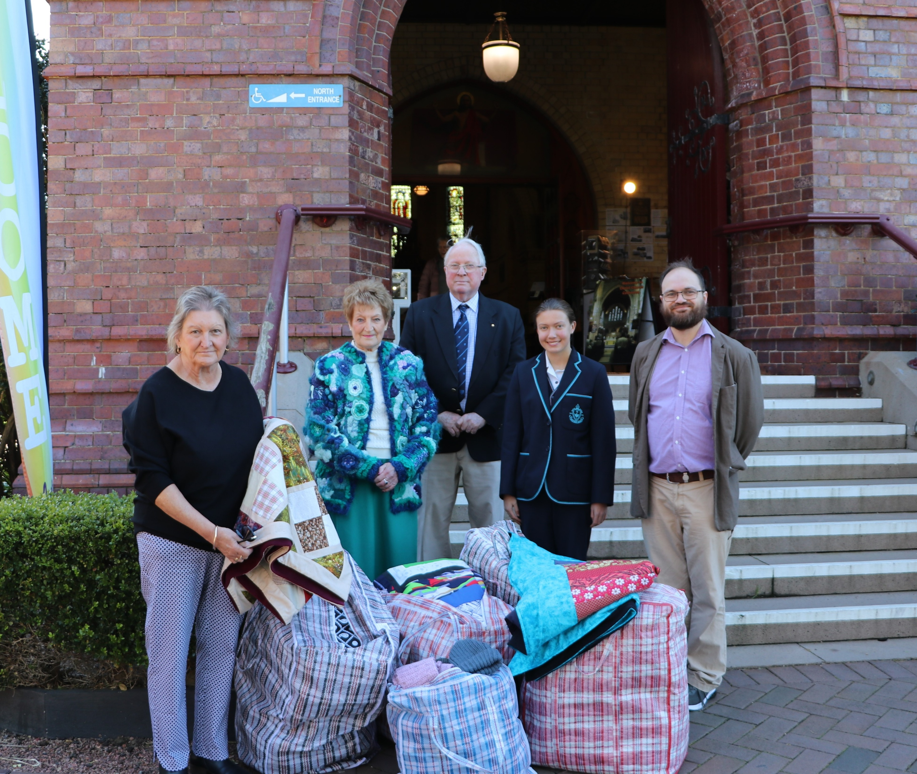
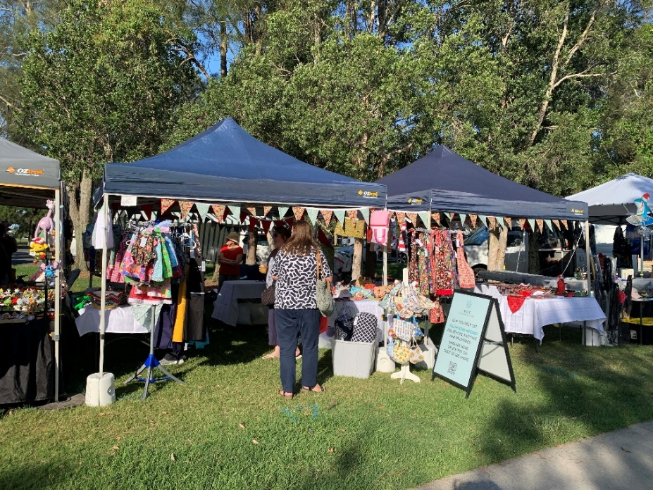
Deliveries
Blanket Recipients
2,665 Fleece Backed Blankets
158 Woollen Blankets
734 Crochet/Knitted Blankets
3,557 Total Blankets **
** includes 256 donated by Quirky Quilters
38 Organisations/ Individuals Received our Blankets
Blankets on Hand
2024 Fundraising Success
185 Fleece Backed Blankets
5 Woollen Blankets
67 Crochet/Knitted Blankets
257 Total Blankets
6 major events held
$15,000 Raised
1 major donated quilt raffle raise over $1,000

Slide 5
Grants Received
Fundraising Donations
Newcastle Permanent Charitable Foundation
Belmont 16 Footers Club Grant
Federal Gov’t 23-24 Volunteers Grant
Central Leagues Club Charlestown Club Grant
Jenny Loss Quilts
Bakers Delight Warners Bay
Wine Selectors Newcastle
Newcastle Permanent
Belmont 16’s
Bunnings Belmont
Seaview Malaysian Redhead
Woolworths at Belmont and Mt Hutton.
Brown Sugar restaurant Warners Bay.
Coles at Mt Hutton.
Zenn Beauty at Belmont.
Major Supporters
Quirky Quilters
Women on Wednesday(WoW)
Creating for Charity

Slide 6
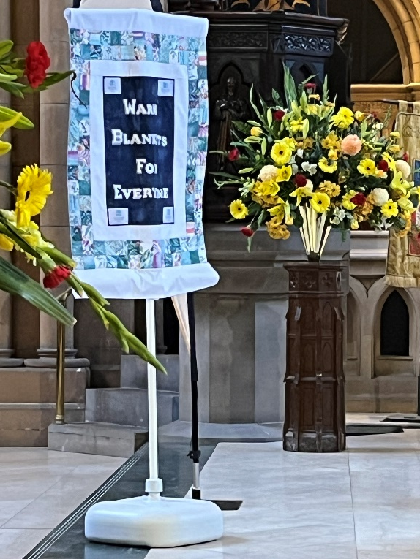
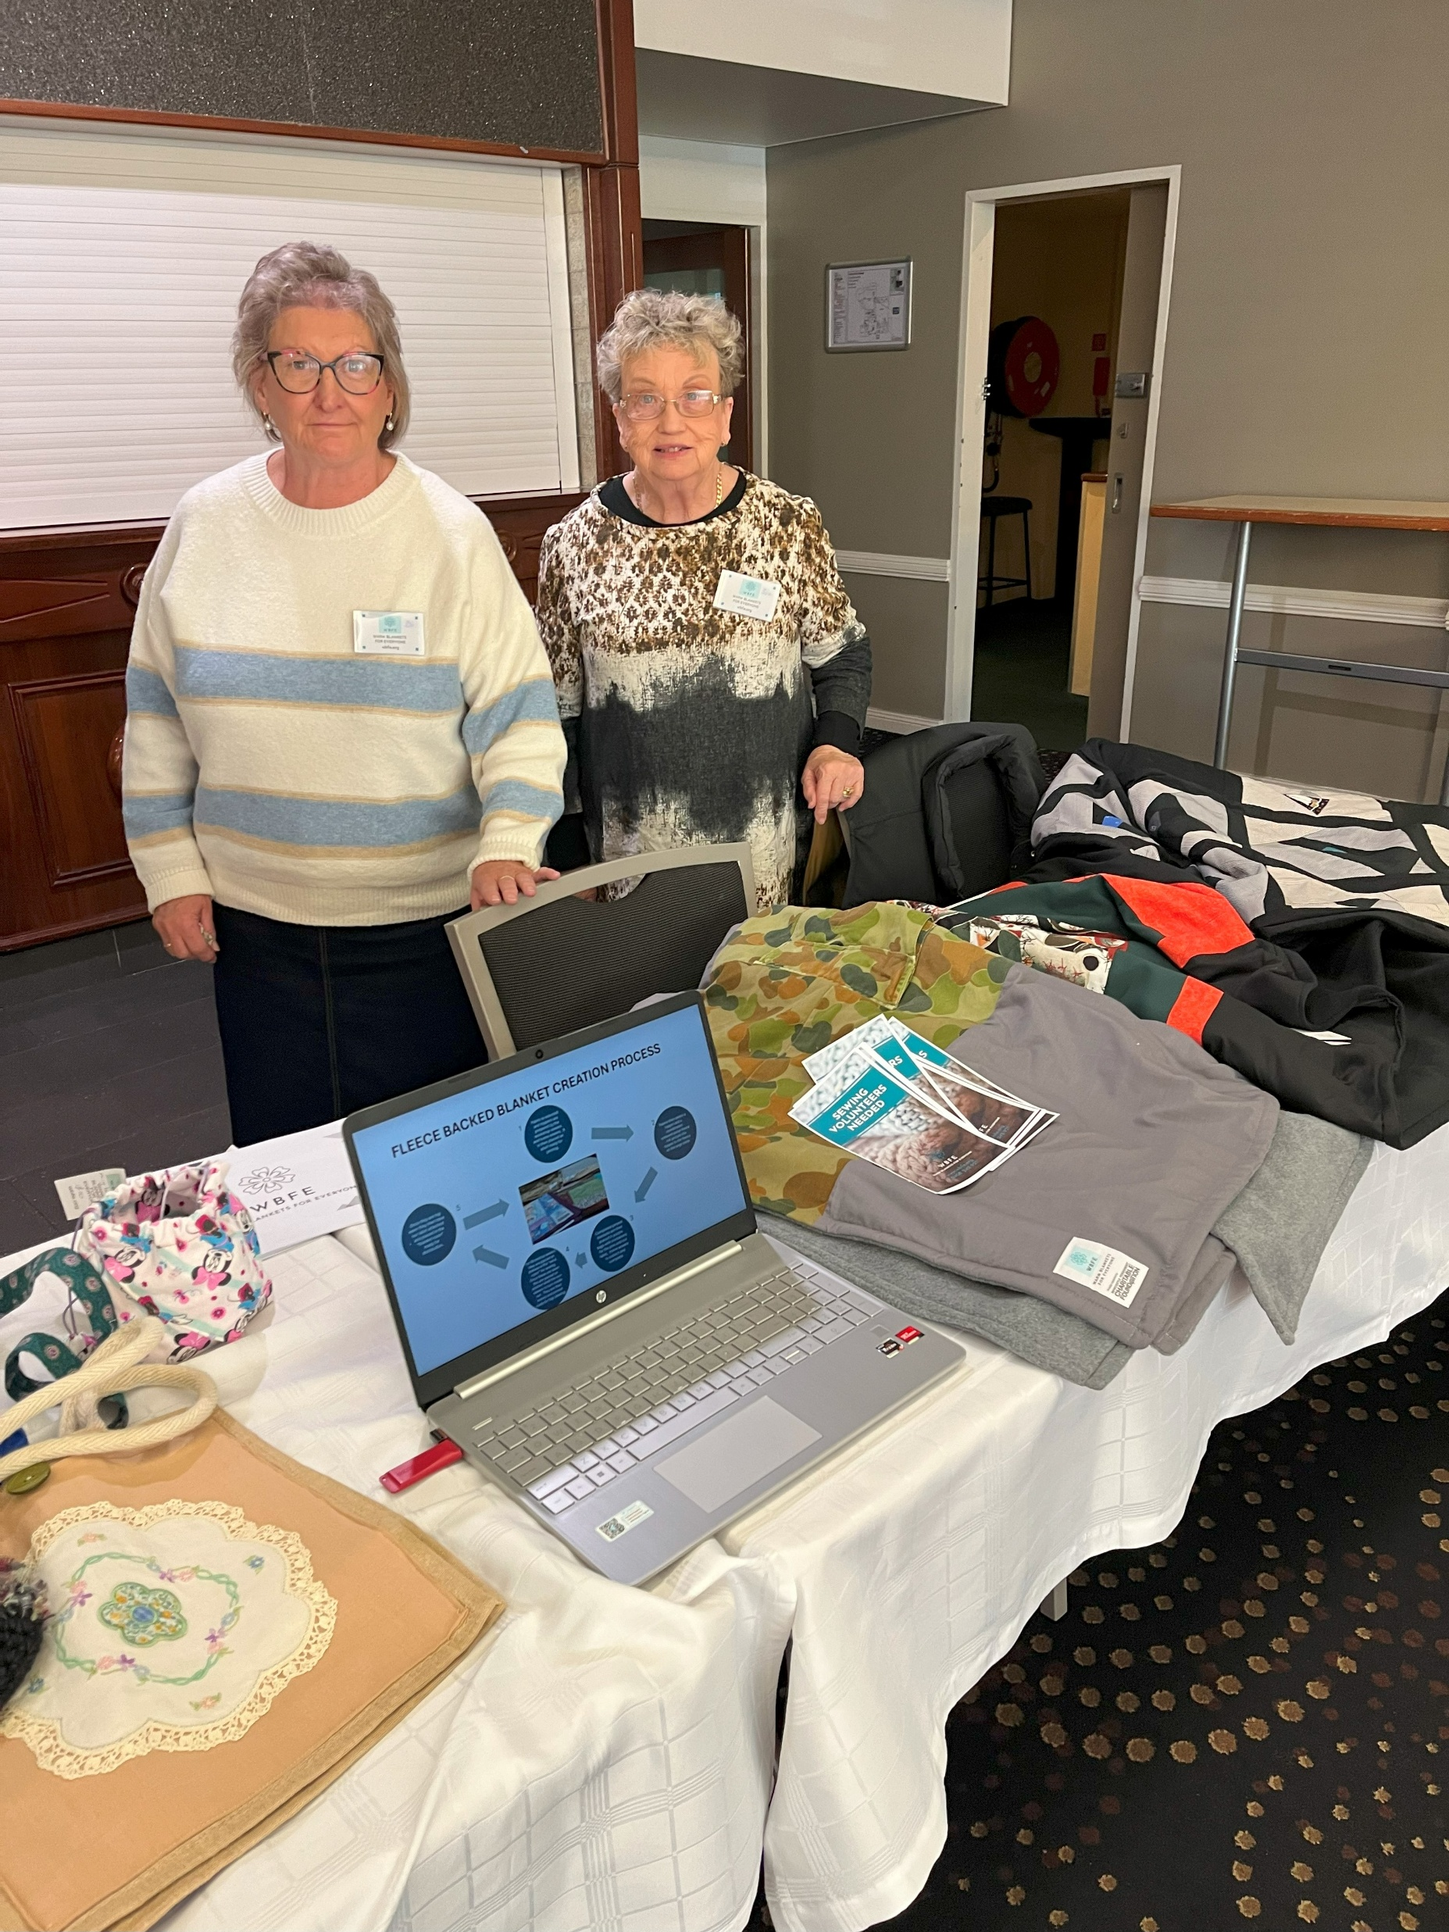
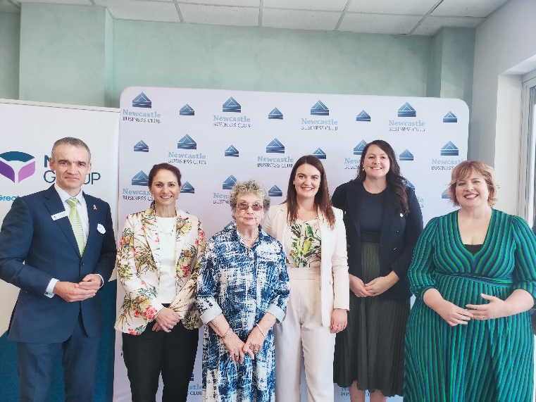
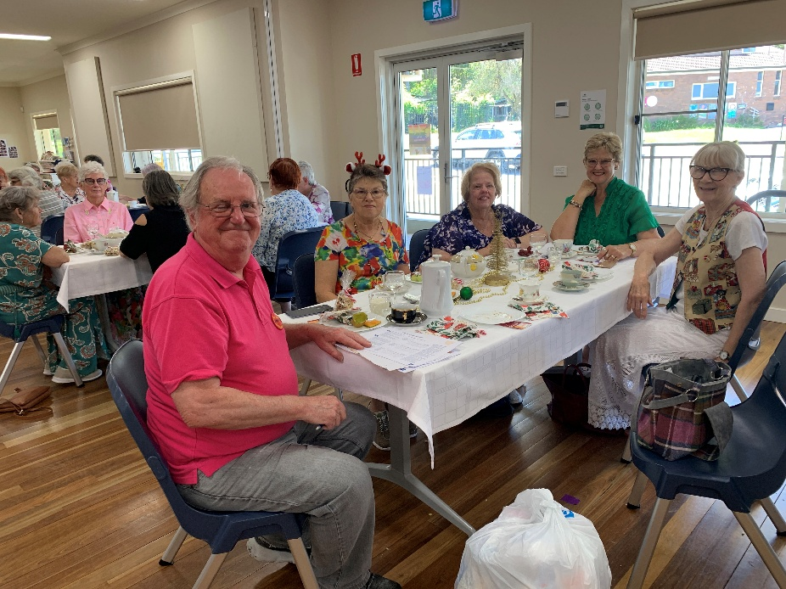
Events & Promotions
Presentations to various community groups conducted
Participated in the Lake Macquarie Rotary Clubs Volunteer Expo
Showcased in the October edition of the Hunter & Coastal Magazine
Belmont 16’s Newsletter article
2024 Newcastle Volunteer Service Award joint recipient
Newcastle Business Club October Lunch panel discussion participant
ZEAL FUTURES web newsletter article “Keeping the Community Warm”
Christ Church Cathedral Community Outreach Program 40th Anniversary Celebration participant

